Slide 1
Historical Perspective

Slide 2
Historical Perspective
Psychology is as old as human history.
Written account of the interest in people’s actions, motives, and thoughts can be traced to ancient times.

Slide 3
Ancient Greece
The Middle Ages
Socrates developed a method of learning called introspection, which means to carefully examine our own thoughts and feelings.
Aristotle outlined associationism, the theory that association with past experiences is a basic principle of mental activity.
Most Europeans of this period believed that psychological problems were caused by possession by demons
They used certain tests to determine whether a person was possessed.

Slide 4
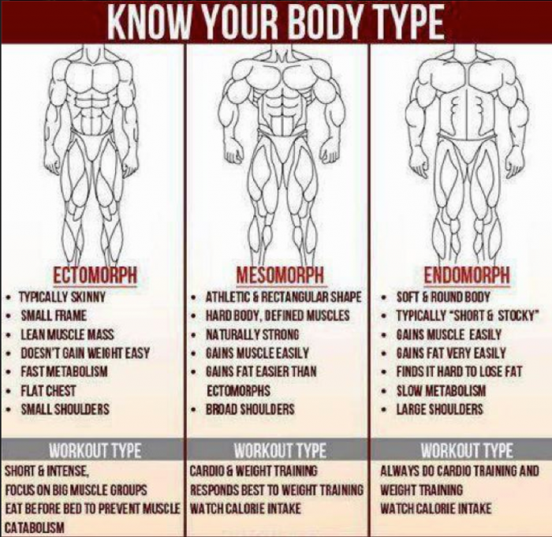
Sheldon’s Somatotype

Slide 5
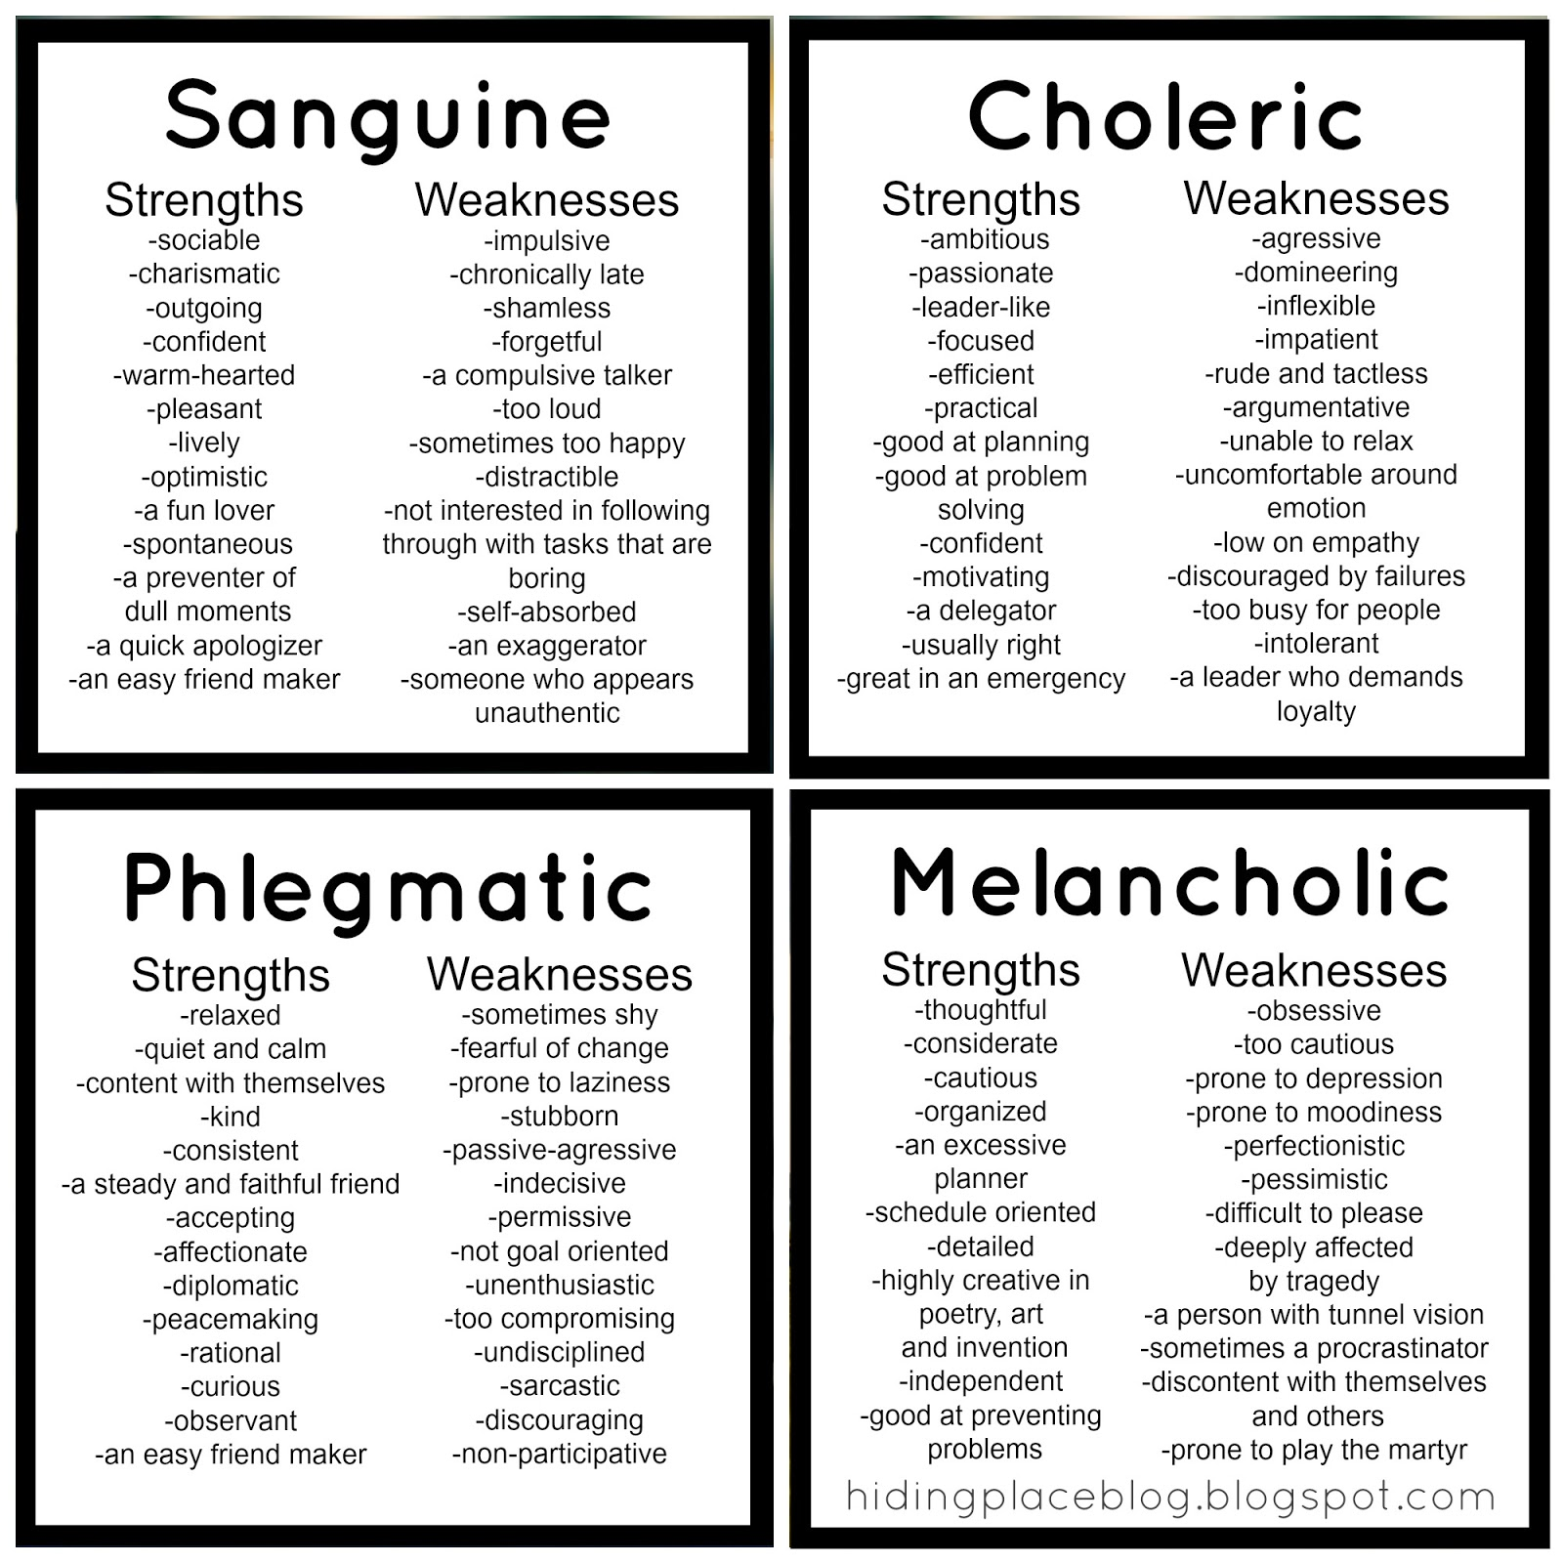
Hippocrates Personality Type

Slide 6
Early Days: Branch of philosophy
Psychology as a Science: Setup a lab in 1879 in Leipzig, Germany
Father of Psychology: Whilhelm Wundt

Slide 7
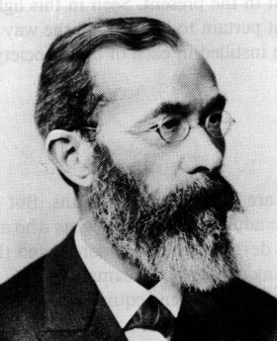
Structuralism
Wundt and Titchner
Focus of the study: Structure of mental processes
Analysis of experience in terms of its ‘elements’, ‘specific components’ or ‘building blocks’
Methods of Analysis: Introspection
Observing and reporting mental processes, feelings, and experiences as accurately as possible
Criticism: lack of objectivity

Slide 8
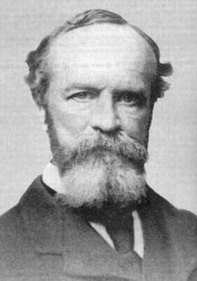
Functionalism
William James: Broadened the scope of Psychology
Published a book on Principles of Psychology
Focus of the study: How mind functions to adapt us to our environment
Influenced by Darwinian's theory of natural selection
Impact of functionalism on Psychology: Study of animals, educational psychology, industrial psychology

Slide 9
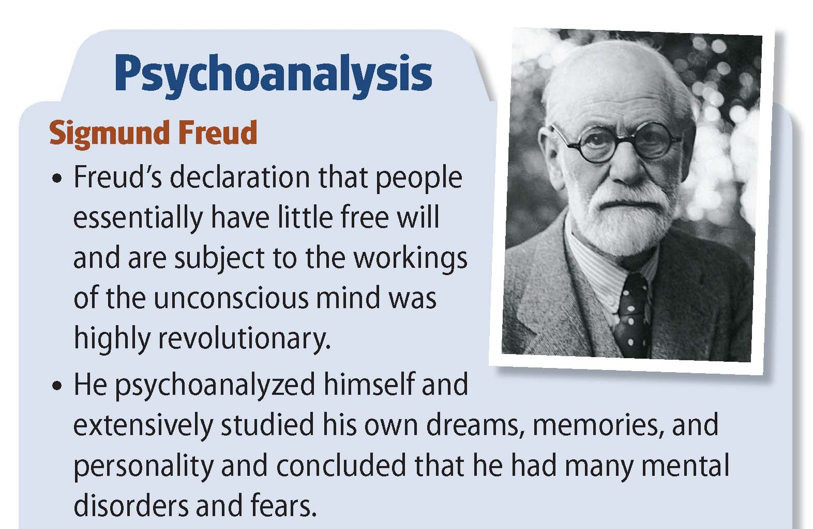

Slide 10
Sigmund Freud and Psychoanalysis
He theorized that the key to human behavior is satisfying desires.
Freud was the most famous of the early psychologists.
He developed psychoanalysis, which emphasizes unconscious motives and internal conflicts in human behavior.
He developed psychodynamic thinking, which assumes that most of what exists in an individual's mind is unconscious and consists of conflicting impulses, urges, and wishes.

Slide 11
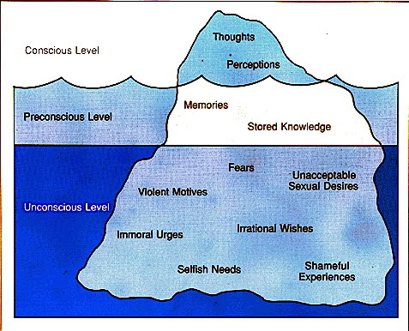
“Freud’s Iceberg”

Slide 12
Mind and iceberg: Three levels of Mind
Conscious
Subconscious
Unconscious
Structure of Personality:
ID: Pleasure Principle
EGO: Reality Principle (Executive of Personality )
Superego: Moral Principles
Types of Anxiety:
Id x Ego: Neurotic Anxiety
Superego x Ego: Moral Anxiety

Slide 13
Basic Concept
In Sigmund Freud's topographical model of personality, the ego is the aspect of personality that deals with reality.
While doing this, the ego also has to cope with the conflicting demands of the id and the superego.
The id seeks to fulfill all wants, needs, and impulses while the superego tries to get the ego to act in an idealistic and moral manner.
What happens when the ego cannot deal with the demands of ones desires, the constraints of reality, and ones own moral standards? Anxiety acts as a signal to the ego that things are not going right.

Slide 14
Basic concept
He identified three different types of anxiety.
Reality Anxiety: This is the most basic form of anxiety and is typically based on fears of real and possible events, such as being bitten by a dog or falling from a ladder.
The most common way of reducing tension from Reality Anxiety is taking oneself away from the situation, running away from the dog or simply refusing to go up the ladder.
Neurotic Anxiety: This is a form of anxiety which comes from an unconscious fear that the basic impulses of the ID (the primitive part of our personality) will take control of the person, leading to eventual punishment(this is thus a form of Moral Anxiety).
Moral Anxiety: This form of anxiety comes from a fear of violating values and moral codes, and appears as feelings of guilt or shame.

Slide 15
Basic concept
According to Freud, anxiety is an unpleasant inner state that people seek to avoid.
When anxiety occurs, the mind first responds by an increase in problem-solving thinking, seeking rational ways of escaping the situation.
If this is not fruitful (and maybe anyway), ego has some tools it can use in its job as the mediator, tools that help defend the ego, these are called Ego Defense Mechanisms or Defenses.
They helped shield the ego from the conflicts created by the id, superego, and reality.

Slide 16
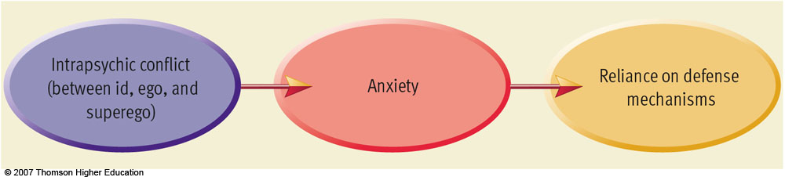
Basic concept

Slide 17
Important properties
Defenses are a major means of managing impulse and affect
Defenses are unconscious
Defenses are discrete from one another
Although often the hallmarks of major psychiatric syndromes, defenses are dynamic and reversible;
Defenses can be adaptive as well as pathological.

Slide 18
Defense Mechanism
The ego’s protective methods of reducing anxiety
Ego defenses are not necessarily unhealthy as one thinks.
In fact, the lack of these defenses, or the inability to use them effectively can often lead to problems in life.
However, we sometimes employ the defenses at the wrong time or overuse them, which can be equally destructive.

Slide 19
Denial: Arguing against an anxiety provoking stimuli by stating it doesn't exist.
Displacement: Taking out impulses on a less threatening target.
Intellectualization: Avoiding unacceptable emotions by focusing on the intellectual aspects.
Projection: Placing unacceptable impulses in yourself onto someone else.

Slide 20
Rationalization: Supplying a logical or rational reason as opposed to the real reason. Reaction Formation: Taking the opposite belief because the true belief causes anxiety. Regression: Returning to a previous stage of development. Repression: Pulling into the unconscious. Forgetting sexual abuse from your childhood due to the trauma and anxiety

Slide 21
Sublimation: acting out unacceptable impulses in a socially acceptable way. sublimating your aggressive impulses toward a career as a boxer; becoming a surgeon because of your desire to cut; lifting weights to release 'pent up' energy
Acting Out: The individual deals with emotional conflict or internal or external stressors by actions rather than reflections or feelings.

Slide 23
Behaviourism
John B.Watson: Objected the study of mind or conscious experience
Criticized the method of Introspection
Behaviourists advocated the study of overt, observable behaviour
Studied the relationship between stimuli (event) and response
Used Pavlov’s concept of ‘conditioning’ to explain behaviour

Slide 24
Radical Behaviourism: B.F. Skinner
Behaviour is learned and maintained by its consequences
Positive reinforcement vs. Negative reinforcement
Cognitive Behaviourism
Advocated the role of thinking and other mental processes

Slide 25
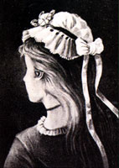
Gestalt Psychology
It emphasized the study of thinking, learning, and perception in whole units, not by analysis into parts
Gestalt Principles : Law of similarity, continuation, closure, symmetry etc.
This may seem like one picture,
but it can be perceived as 3 different faces.
Can you find them?

Slide 26
Humanistic Psychology
It emphasizes understanding a human from his own eyes
Rejected the Freudian idea that behaviour is governed by unconscious forces
Criticized behaviourists view of conditioning
It places high value for human potentials
“ People can freely choose to live more creative, meaningful and satisfying life’

Slide 27
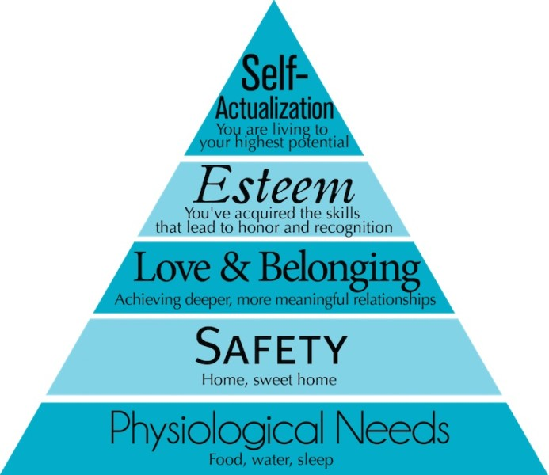

Slide 28
Subfields and Applications of Psychology
Developmental Psychology: Deals with how people change physically, cognitively, and socially across life span
Educational Psychology: Deals with all the aspects of educational process such as, mode of teaching and instruction, techniques of instruction, learning disability etc.
Cognitive Psychology: Deals with all the aspects of cogition such as, learning, memory, thinking, reasoning, decision making etc.
Industrial/ Organizational Psychology: Studies all aspect of behaviour in organizational setup such as, how to improve the productivity of employees, training programme for employees, designing a system of performance appraisal

Slide 29
Psychobiology: Investigate the biological basis of behaviour
Social Psychology: How social context affects the behavior of the individual and groups. It takes into account all aspects of social behaviour and and thought.
Experimental Psychology: Deals with all aspects of basic psychological processes such as, perception, learning, thnking, motivation etc.
Health or Medical Psychology: Aims to study the role of psychological factors in influencing and marinating physical health. It also emphasizes the promotion of good physical health
Abnormal Psychology: Deals with various forms of psychopathology
Clinical Psychologists: Deals with the diagnosis and treatment of psychological disorders

Slide 30
Environmental Psychology: Deals with the relationship between humans and the physical environment
Engineering Psychology: Deals with designing machines, products, services or tasks considering human limitations
Forensic Psychology: Deals with the possible association between psychopathology and criminal behaviour

